Slide 1
Page Object Model
Trainer: Rex Jones II

Slide 2
Page Object Model
Video Series
Introduce Page Object Model
How To Create A Page Object Model
Create First Test Using Page Object Model
Rex Jones II

Slide 3
Page Object Model
Video Series
Introduce Page Object Model
How To Create A Page Object Model
Create First Test Using Page Object Model

Slide 4
What Is A Page Object Model

Slide 5
Page Object Model
Design Pattern
Page Objects (Elements & Interactions)
Test Scripts
Elements & Interactions are stored separate from Test Scripts

Slide 6
Page Object Model
Design Pattern
Web Pages
Page Objects
Test Scripts
Test Script 1
Login Page
LoginPage (Variables & Methods)
Test Script 2
Home Page
HomePage (Variables & Methods)
Test Script 3

Slide 7
Why Is POM
Important

Slide 8
Benefits of Page Object Model

Slide 9
Page Object Model
Video Series
Introduce Page Object Model
How To Create A Page Object Model
Create First Test Using Page Object Model

Slide 10
BasePage

Slide 11
LoginPage

Slide 12
ProductsPage

Slide 13
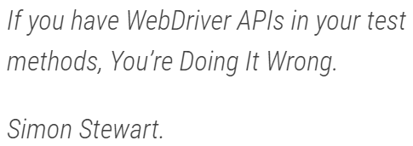
WebDriver
API’s

Slide 14
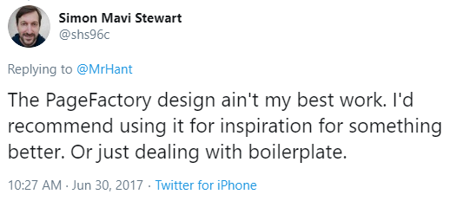

Slide 15
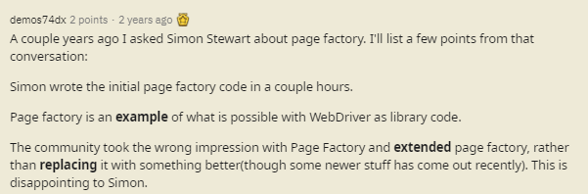

Slide 16
Page Object Model
Video Series
Introduce Page Object Model
How To Create A Page Object Model
Create First Test Using Page Object Model

Slide 17
BaseTest

Slide 18
Login Test Functionality

Slide 19
Product Test Functionality

